Slide 1
Program, Lexical, Primitive Data Types, Literals, Variables

Slide 2
First JAVA Program
class abc
{
public static void main(String arg[]){
System.out.print(“Hello Everyone");
}
}
Save:
For this example, the name of the source file should be abc.java.
Compiling the Program:
execute the compiler javac
The javac compiler creates a file, abc.class that contains the bytecode version of the program. As discussed earlier, the Java bytecode is the intermediate representation of your program that contains instructions the Java Virtual Machine will execute.

Slide 3
First JAVA Program
class abc
{
public static void main(String arg[]){
System.out.print(“Hello Everyone");
}
}
Execute or Run the program :
you must use the Java application launcher (interpreter), java. And pass the class name eg. Java abc
Keep in mind that Java is case-sensitive.
main( ) is simply a starting place for your program. A complex program may have dozens of classes, only one of which will need to have a main() method to get things started.

Slide 4
Lexical
Java programs are a collection of whitespace, identifiers, literals, comments, operators, separators, and keywords.

Slide 5
Lexical
Whitespace: whitespace is a space, tab, or newline.
Java is a free-form language. This means that you do not need to follow any special indentation rules.
For instance, the Example program could have been written all on one line or in any other strange way
Identifiers:
Identifiers are used to name things, such as classes, variables, and methods.
An identifier may be any descriptive sequence of uppercase and lowercase letters, numbers, or the underscore and dollar-sign characters.
They must not begin with a number.

Slide 6
Lexical
Literals: A constant value.
For instance, Integer 10
floating-point value 1.414
character constant ‘A’
and string “Ram”
Comments:
there are three types of comments defined by Java.
single-line //Single line comments
Multiline /*Multiple line comments*/
Documentation comment /** documentation comments*/
Documentation comment is used to produce an HTML file that documents your program. They must not begin with a number.

Slide 7
Lexical
Javadoc is a tool which comes with JDK and it is used for generating Java code documentation in HTML format from Java file.
We can include HTML tags inside the javadoc description.
Tag | Description | Syntax
@author | Adds the author of a class. | @author name-text
{@code} | Displays text in code font without interpreting the text as HTML markup or nested javadoc tags. | {@code text}
@deprecated | Adds a comment indicating that this API should no longer be used. | @deprecated deprecatedtext
@exception | Adds a Throws subheading to the generated documentation, with the classname and description text. | @exception class-name description
{@link} | Inserts an in-line link with the visible text label that points to the documentation for the specified package, class, or member name of a referenced class. | {@link package.class#member label}
@param | Adds a parameter with the specified parameter-name followed by the specified description to the "Parameters" section. | @param parameter-name description
@return | Adds a "Returns" section with the description text. | @return description
@see | Adds a "See Also" heading with a link or text entry that points to reference. | @see reference
@since | Adds a "Since" heading with the specified since-text to the generated documentation. | @since release
@throws | The @throws and @exception tags are synonyms. | @throws class-name description
@version | Adds a "Version" subheading with the specified version-text to the generated docs when the -version option is used. | @version version-text

Slide 8
Lexical
Operators
There are many types of operators in Java
Unary Operator ++,-- (prefix and postfix)
Arithmetic Operator + - * / %
Shift Operator << >> >>>
Relational Operator < > <= >= == !=
Bitwise Operator & ^ |
Logical Operator && ||
Ternary Operator ? :
Assignment Operator = += -= *= /= %= &= ^= |= <<= >>= >>>=

Slide 9
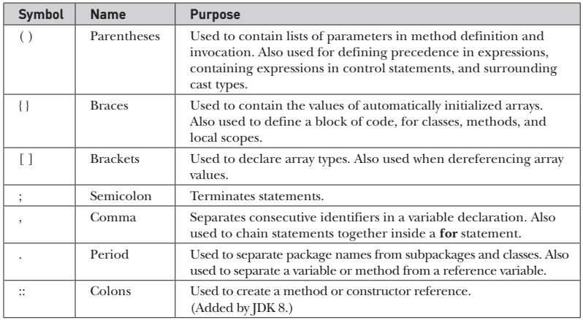
Lexical
Separators:
The most commonly used separator in Java is the semicolon. As you have seen, it is used to terminate statements.

Slide 10
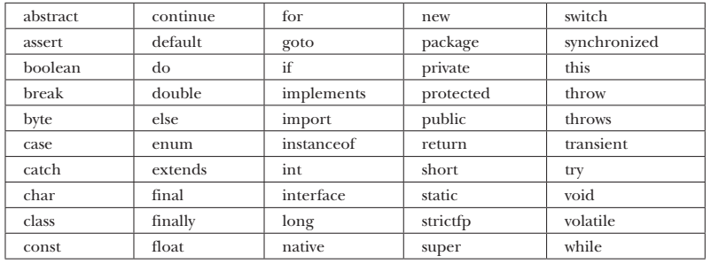
Lexical
keywords :
The keywords, combined with the syntax of the operators and separators.

Slide 11
Lexical
keywords :
These keywords cannot be used as identifiers. Thus, they cannot be used as names for a variable, class, or method.
The keywords const and goto are reserved but not used.
In addition to the keywords, Java reserves the following: true, false, and null. These are values defined by Java. You may not use these words for the names of variables, classes, and so on.

Slide 12
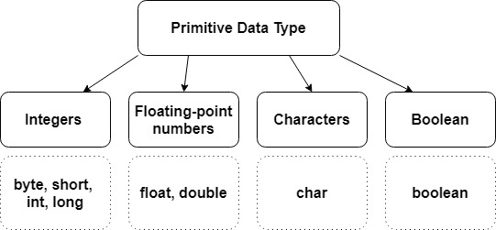
Data Types
Java defines eight primitive types of data: byte, short, int, long, char, float, double, and boolean.
The primitive types represent single values—not complex objects.
Integers: This group includes byte, short, int, and long, which are for whole-valued signed numbers.

Slide 13
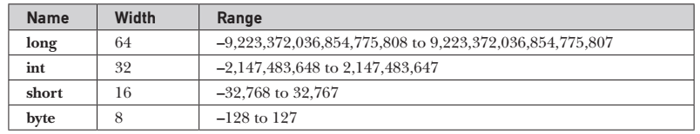
Data Types: Integers
All of these are signed, positive and negative values.
Java does not support unsigned, positive-only integers.
Byte: The smallest integer type is byte. This is a signed 8-bit type that has a range from –128 to 127.
Byte variables are declared by use of the byte keyword.

Slide 14
Data Types: Integers
short: short is a signed 16-bit type.
It has a range from –32,768 to 32,767.
It is probably the least used Java type. Short variables are declared by use of the short keyword.

Slide 15
Data Types: Integers
int : The most commonly used integer type is int.
It is a signed 32-bit type that has a range from –2,147,483,648 to 2,147,483,647.
In addition to other uses, variables of type int are commonly employed to control loops and to index arrays.

Slide 16
Data Types: Integers
Although you might think that using a byte or short would be more efficient than using an int in situations in which the larger range of an int is not needed, this may not be the case.
The reason is that when byte and short values are used in an expression, they are promoted to int when the expression is evaluated.

Slide 17
Data Types: Integers
long: long is a signed 64-bit type and is useful for those occasions where an int type is not large enough to hold the desired value.
The range of a long is quite large.

Slide 18
Data Types
Java defines eight primitive types of data: byte, short, int, long, char, float, double, and boolean.
Floating-point numbers: This group includes float and double, which represent numbers with fractional precision.

Slide 19
Data Types: Floating-Point Types
floating-point numbers: Floating-point numbers, also known as real numbers, are used when evaluating expressions that require fractional precision.
There are two kinds of floating-point types, float and double, which represent single- and double-precision numbers, respectively.

Slide 20

Data Types: Floating-Point Types
float: The type float specifies a single-precision value that uses 32 bits of storage.
Float variables are declared by use of the float keyword.

Slide 21
Data Types: Floating-Point Types
double: Double precision, as denoted by the double keyword, uses 64 bits to store a value.
All transcendental math functions, such as sin( ), cos( ), and sqrt( ), return double values.

Slide 22
Data Types
Java defines eight primitive types of data: byte, short, int, long, char, float, double, and boolean.
Characters: This group includes char, which represents symbols in a character set, like letters and numbers.

Slide 23
Data Types: Characters
Characters: the data type used to store characters is char.
Java uses Unicode to represent characters.
in Java char is a 16-bit type.
It has a minimum value of '\u0000' (or 0) and a maximum value of '\uffff' (or 65,535 inclusive).
The range of a char is 0 to 65,536.
There are no negative chars.
The standard set of characters known as ASCII still ranges from 0 to 127 as always, and the extended 8-bit character set, ISO-Latin-1, ranges from 0 to 255..

Slide 24
Data Types
Java defines eight primitive types of data: byte, short, int, long, char, float, double, and boolean.
Boolean: This group includes boolean, which is a special type for representing true/false values.

Slide 25
Data Types: Booleans
Booleans: Java has a primitive type, called boolean, for logical values.
It can have only one of two possible values, true or false.
This is the type returned by all relational operators.

Slide 26
Data Types: Default Values
It's not always necessary to assign a value when a field is declared.
Fields that are declared but not initialized will be set to a reasonable default by the compiler.
Generally speaking, this default will be zero or null, depending on the data type.
Data Type | Default Value
byte | 0
short | 0
int | 0
long | 0L
float | 0.0f
double | 0.0d
char | '\u0000'
String (or any object) | null
boolean | FALSE

Slide 27
Data Types: Default Values
Local variables are slightly different.
The compiler never assigns a default value to an uninitialized local variable.
If you cannot initialize your local variable where it is declared, make sure to assign it a value before you attempt to use it.
Accessing an uninitialized local variable will result in a compile-time error.

Slide 28
Literals
Literals can be assigned to any primitive type data.
Here are different types of literals corresponding to the primitive data types in Java.
Integer Literals:
Any whole number value is an integer literal. Examples are 1, 2, 3, and 42. These are all decimal values, meaning they are describing a base 10 number.
There are 4 types of integer literals in Java:
binary (base 2)
decimal (base 10)
octal (base 8)
hexadecimal (base 16)

Slide 29
Literals
binary (base 2)
binary literals starts with 0b or 0B. (defined in JDK 7)
decimal (base 10)
octal (base 8)
Octal values are denoted in Java by a leading zero (0).
hexadecimal
hexadecimal constant values are denoted by leading zero-x, (0x or 0X).
In JDK 7, you can embed one or more underscores in an integer literal.
Doing so makes it easier to read large integer literals. When the literal is compiled, the underscores are discarded.

Slide 30
Literals
public class abc
{
public static void main(String arg[]) {
abc obj=new abc();
int hexVal = 0x1a;
int octVal = 032;
int binVal = 0b11010;
System.out.print(“hexa Value=“+hexVal+“ Octal Value="+octVal+“ Binary Value="+binVal);
}
}

Slide 31
Literals
Floating-Point Literals:
Floating-point numbers can be expressed in either standard or scientific notation.
Standard notation consists decimal point followed by a fractional component. For example, 2.0, 3.14159, and 0.6667.
Scientific notation uses a standard-notation, floating-point number plus a suffix that specifies a power of 10 by which the number is to be multiplied.
The exponent is indicated by an E or e followed by a decimal number, which can be positive or negative. Examples include 6.022E23, 314159E–05, and 2e+100.

Slide 32
Literals
Floating-Point Literals:
Floating-point literals in Java default to double precision.
To specify a float literal, you must append an F or f to the constant.
You can also explicitly specify a double literal by appending a D or d.
You can embed one or more underscores in a floating-point literal. This feature works the same as it does for integer literals.
It is also permissible to use underscores in the fractional portion of the number.

Slide 33
Literals
Boolean Literals:
Boolean literals are simple.
There are only two logical values that a boolean value can have, true and false.
The values of true and false do not convert into any numerical representation.
Boolean literals can only be assigned to variables declared as boolean or used in expressions with Boolean operators

Slide 34
Literals
Character Literals:
Characters in Java are indices into the Unicode character set.
They are 16-bit values that can be converted into integers and manipulated with the integer operators, such as the addition and subtraction operators.
A literal character is represented inside a pair of single quotes.
For characters that are impossible to enter directly, there are several escape sequences that allow you to enter the character you need, such as '\'' for the single-quote character itself and '\n' for the newline character.

Slide 35
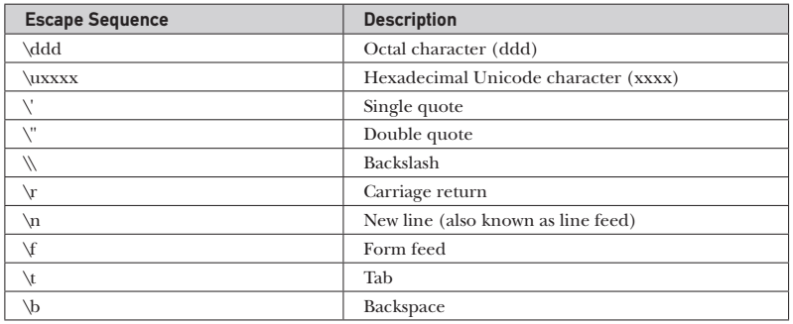
Literals
Character Literals:
There is also a mechanism for directly entering the value of a character in octal or hexadecimal.
For octal notation, use the backslash followed by the three-digit number. For example, ' \141' is the letter 'a'.
For hexadecimal, you enter a backslash-u ( \u), then exactly four hexadecimal digits. For example, '\u0061' is the letter 'a‘.

Slide 36
Literals
String Literals:
Strings are actually object types in Java.
String literals are specified like they are in most other languages—by enclosing a sequence of characters between a pair of double quotes.
The escape sequences and octal/hexadecimal notations that were defined for character literals work the same way inside of string literals.
One important thing to note about Java strings is that they must begin and end on the same line.
There is no line-continuation escape sequence as there is in some other languages

Slide 37
Variables
The variable is the basic unit of storage in a Java program.
A variable is defined by the combination of an identifier, a type, and an optional initializer.
type identifier = value
type is one of Java’s atomic types, or the name of a class or interface.
The identifier is the name of the variable.
You can initialize the variable by specifying an equal sign and a value.
For instance, int a=10;
In addition, all variables have a scope, which defines their visibility, and a lifetime.
All variables must be declared before they can be used.
To declare more than one variable of the specified type, use a comma-separated list. For instance, int a, b=5,c=10;

Slide 38
Variables
Variables Initialization:
Although the preceding examples have used only constants as initializers
In Java variables can be initialized dynamically, using any expression valid at the time the variable is declared.
For instance,
int a=10, b=20,c;
c=a+b;

